Slide 1
NAV’s Horizon Scan 2023–2035
Societal trends towards 2035 and consequences for NAV (Norwegian Labour and Welfare Administration)
Notes:
Thank you for the opportunity to give a brief presentation of our Horizon Scan. NAV’s Horizon Scan addresses key societal trends that are likely to affect the labour and welfare area in the years leading up to 2035. In addition we discuss uncertainties associated with each trend, and the consequences these trends may have for NAV. NAV is the Norwegian Labour and Welfare Administration, and we are not only responsible for labour market services. We are also responsible for administering most of the social security benefits in Norway, as well as pensions, and we are also responsible for social services. This report covers all those areas.
Today I will speak mostly about how we use this analysis, and how we have created the analysis. But I will also give you a very few main findings.

Slide 2
Purpose of the Horizon Scan
1
2
Reflection and discussion of how societal trends affect NAV in general and your field in particular
Contribute to more accurate strategies and priorities for NAV
Society is changing rapidly. NAV must change with it, in step with new opportunities and challenges, and taking into account unexpected developments.
NAV’s employees are the target audience, but we also want to reach decision-makers and partners.
Notes:
There are mainly two reasons why we need this report:
The first is that it helps us to create more accurate strategies and priorities.
The second reason is we want all our employees to reflect on how the world around us will change, and what it will mean for our organization in general, and what it will mean for the different units where people work.
Our own employees is the main target audience for the report, but we believe the report to be quite useful also for example for politicians and for our partner, for example for everybody who needs an analysis of future trends in the labour market.

Slide 3
^{7 societal areas}
Labour market
Demographics
User expectations
Technology
Living conditions
Health
Political trends
Notes:
The Horizon Scan covers these seven societal areas: Labour market, demographics, user expectations, technology, living conditions, health and political trends.

Slide 4
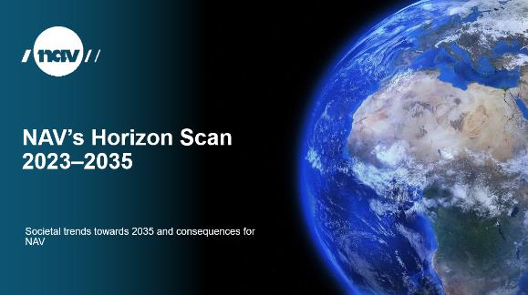
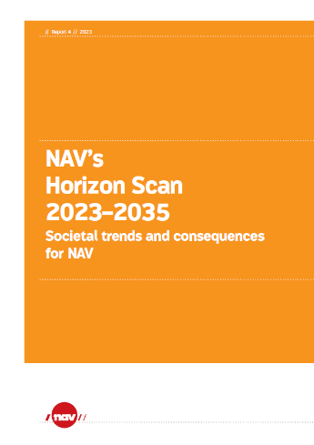
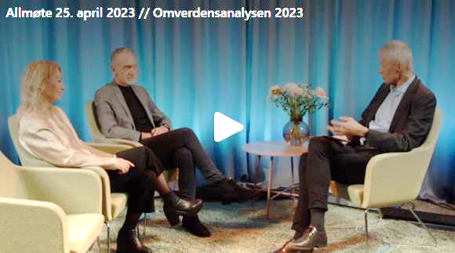
How did we create the analysis?
1–2 experts responsible for each societal area
Workshops with internal and external experts and stakeholders
Surveys sent to our own employees and user representatives
Seminar on publishing day, 25 April
Notes:
How did we create this analysis:
We have appointed 1-2 experts on each of the 7 societal areas. Their tasks have to been to find and summarize relevant research and analysis, and to contextualize it for our purpose, and in some cases also create new analysis for the report.
In addition we have organized workshops with internal and external experts and stakeholders. The purpose is discuss what trends may be the most important ones, and also to discuss what consequences the trends will have for our organization – what opportunities and challenges it may give us.
We have also carried out to surveys, one sent out to our own employees, and one sent out to user representatives. We asked them what societal trends they believe will be the most important for our organization. We also asked whether they are familiar with the Horizon Scan, if they find the Horizan Scan useful, and whether they believe that the Horizon Scan actually affects our priorities. This helps us to make the Horizon Scan relevant and to continually improve it. And luckily we have found the our employees find this analysis increasingly useful.

Slide 5
Societal trends and NAV toward 2035
Ageing and centralization challenge the welfare state and NAV
Immigration trends increasingly uncertain
Digitalisation and AI: New expectations and opportunities
Financing models, lack of ICT specialists may slow rate of development
Restructuring and labour shortages
Global unrest and vulnerability: Lower growth, increased regionalisation of international trade
Risk of increased polarisation and reduced trust a challenge for NAV and may lead to increased political unpredictability
Notes:
Here I’ve summarized a few of the main findings of our Horizon Scan. I will have to be very brief here.
We find the ageing and centralization will be increasing challenge for our organization and the welfare state. We believe that immigration trends will be increasingly uncertain, due to global unrest, climate change, and that is more difficult than before to attract labour migrants, due to an ageing population all over Europe.
The labour market will be characterized by a high degree of restructuring due to technological change and the green transition. And we believe labour shortages will be an ongoing problem.
Global unrest will lead to lower economic growth and more regionalisation of international trade.
Digitalisation and AI will change user expectations and give us new opportunities. However, difficulties in finding good financing models and the lack of ICT specialists may slow down the rate of development.
We believe that increased inequality and poverty may give rise to increased polarisation. This may lead to reduced trust in the authorities, and we also believe that is may lead to increased political unpredictability.

Slide 6
Want to know more?
English report and presentation can be found here:
nav.no/omverdensanalyse
Notes:
If you want to know more, you can access this web page, where you will find the report and a more detailed presentation. The English version of the report and the presentation was actually published yesterday.
Thank you for your attention!

